Slide 1

Dimensionality Reduction with
Principal Component Analysis
Name: Trinh Tran
Matriculation: 1105425
Instructor: Damir Dobric
Course: Software Engineering
Date: 2019 - 03 - 12

Slide 2

Layout
Which reduce?
Why reduce?
Introduction
Methods
How reduce ? PCA
Implementation
How reduce ? .NET Core
Unit Test
Test & Discussion
Integration Test
Operational Test

Slide 3




Introduction
Methods
Implementation
“An image is worth a thousand words”
➔ But it’s too much!
Test & Discussion

Slide 4


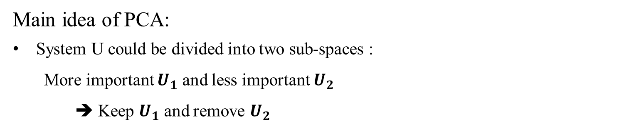

Introduction
Number of points N
K
D- K
N
K
Y
Dimension D
X
=
D
$${U1}_{K}$$
$${U2}_{K}$$
x
Z
Methods
D- K
$$X= U_{1}Y+ U_{2}Z$$
Implementation
Main idea of PCA:
System U could be divided into two sub-spaces :
More important $U_{1}$ and less important $U_{2}$
➔ Keep $U_{1}$ and remove $U_{2}$
Test & Discussion

Slide 5

Introduction
1. Find the mean vector of the input data:
$$\overline{x}= \frac{1}{N}\sum_{n=1}^{N}{x_{N}}$$
2. Transform to the zero-corrected data:
$$\hat{x_{N}}= x_{N}− \overline{x}$$
3. Find covariance matrix:
$$S= \frac{1}{N}\hat{X}{\hat{X}}^{T}$$
4. Compute eigenvalues and eigenvectors of S
5. Sort the eigenvalues descending and choose only K most important elements.
6. Project the input data to the new subspace:
$$Y= U_{K}^{T}\hat{X}$$
Methods
Implementation
Test & Discussion

Slide 6
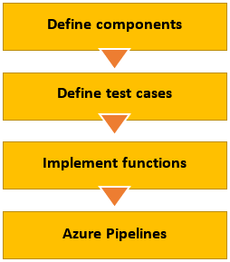
Introduction
Test Driven Development
1. Main component – PCA
2. Linear Algebra Operations (Abstract)
➔ PCA calls LAO
Methods
Based on the LAO (abstract) – define test cases
➔ Test calls LAO
Implementation
Based on the LAO (abstract) – implement functions IF
➔ IF plug to LAO
Test & Discussion
Build + Run Test + Package

Slide 7
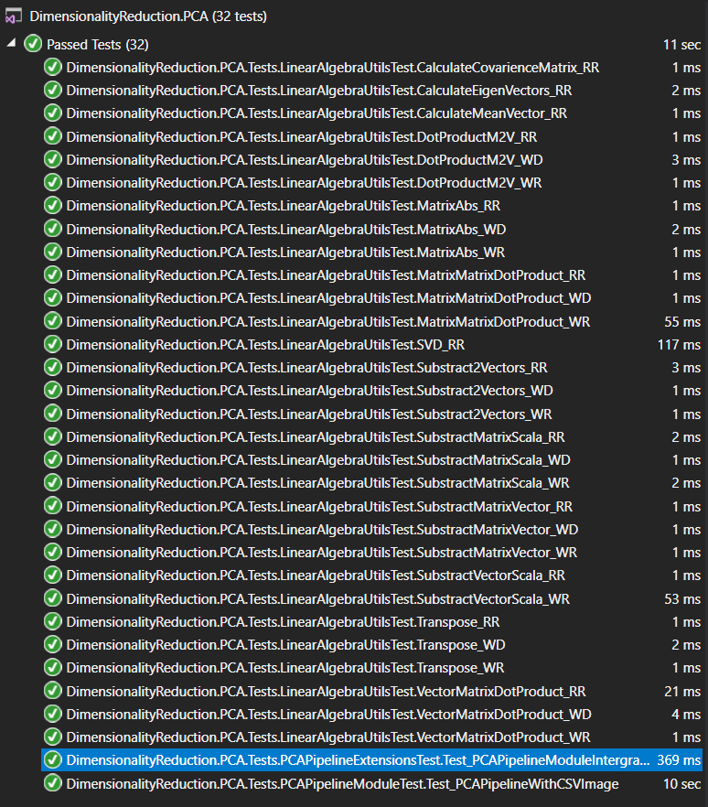
Introduction
Linear Functions such as covariance matrix computation, matrix vector dot product, etc.
Each function should be tested once with a true expectation, a wrong expectation and a wrong dimension.
In summary, there are 32 test cases developed and run successfully with XUnit.
Methods
Implementation
Test & Discussion

Slide 8
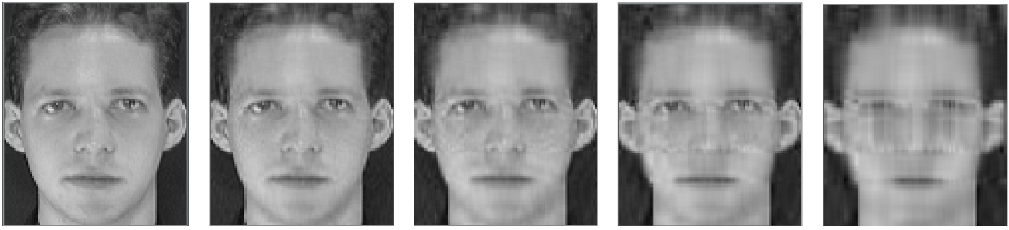
Introduction
Methods
Apply PCA - Reduce dimension to compress an image.
From left to right: input image, loss 1%, loss 3%, loss 5%, loss 10%.
More loss – Less components involved – Less quality output
– Lower dimensional data set - More efficient in processing
Implementation
Test & Discussion

Slide 9
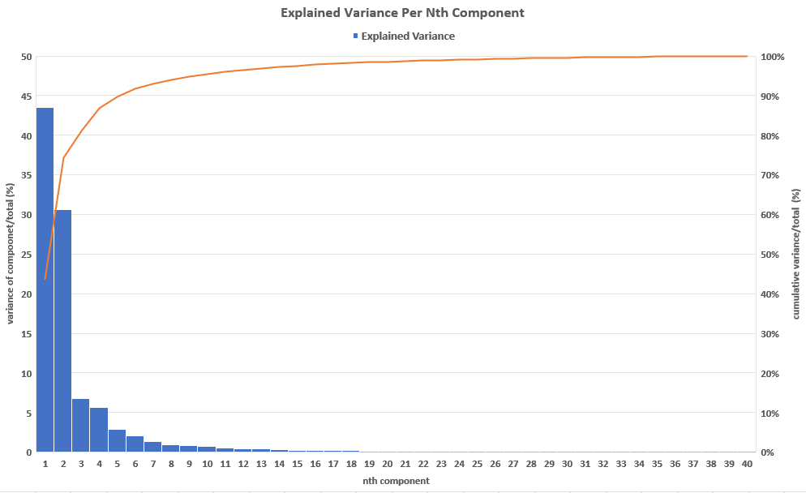
Introduction
Methods
Implementation
No. components ~ their importance.
The blue column is the importance of nth component (descending).
The red line is the level of output quality when cumulating from 1st component to nth component.
Test & Discussion

Slide 10
Thank you for your time!
Name: Trinh Tran
Email: phrong@stud.fra-uas.de
LinkedIn: https://www.linkedin.com/in/trinh-nguyen-phuong-tran-2a0553142/
Date: 2019 - 03 - 12

